Slide 1
Secure Data Hiding in Image Using Steganography
CAPSTONE PROJECT
Presented By:
Student Name : Priya Dharshini R
College Name : Chennai Institute of Technology
Department : Electronics and Communication Engineering

Slide 2
OUTLINE
Problem Statement
Technology used
Wow factor
End users
Result
Conclusion
Git-hub Link
Future scope

Slide 3
Problem Statement
In the digital age, the need for secure communication is paramount. Traditional encryption methods often suffer from visibility and can be intercepted. This project aims to develop a solution for hiding secret messages within image files using steganography. By embedding messages within the least significant bits of image pixels, the system ensures secure and hidden transmission of sensitive information without altering the image’s visual appearance, making it a robust method for data security.

Slide 4
Technology used
Flask: A lightweight web framework for building the web application and handling routing.
Pillow: A Python Imaging Library (PIL) fork used for image processing tasks like opening, editing, and saving images.
NumPy: Utilized for efficient numerical operations on image pixel arrays.
Gunicorn: A WSGI HTTP server for deploying the application in a production environment.
Render: Platform used for hosting and deploying the web application.
HTML/CSS/JavaScript: For frontend development to create the user interface for encryption and decryption functionalities.
Python 3: The primary programming language used to implement encryption, decryption, and image manipulation logic.

Slide 5
Wow factors
Secure Image Steganography: The project integrates image processing with cryptography, allowing users to securely hide and reveal secret messages in images using password-based encryption.
Password Protection: The hidden message is encrypted with a unique password and a hashed password verification, ensuring data privacy and security.
User-Friendly Interface: The web app offers an intuitive interface for both encryption and decryption processes, making it easy for non-technical users to interact with.
Image Integrity: The use of least significant bit (LSB) steganography ensures minimal changes to the original image, preserving its visual quality while embedding the secret message.
Live Hosting on Render: The application is hosted live, providing users with instant access to the image encryption/decryption features from anywhere.

Slide 6
End users
Security Enthusiasts: Individuals interested in cryptography and data security can use the tool to learn and experiment with hiding sensitive information in images.
Professionals Handling Confidential Information: People who need to securely transmit messages or information can use this tool to hide data within images for added protection.
Educators and Students: Teachers and students studying cryptography or computer security can use this project for educational purposes and demonstrations of steganography techniques.
General Public: Anyone looking to add an extra layer of privacy to their personal messages or media files can benefit from the app's easy-to-use encryption/decryption features.

Slide 7
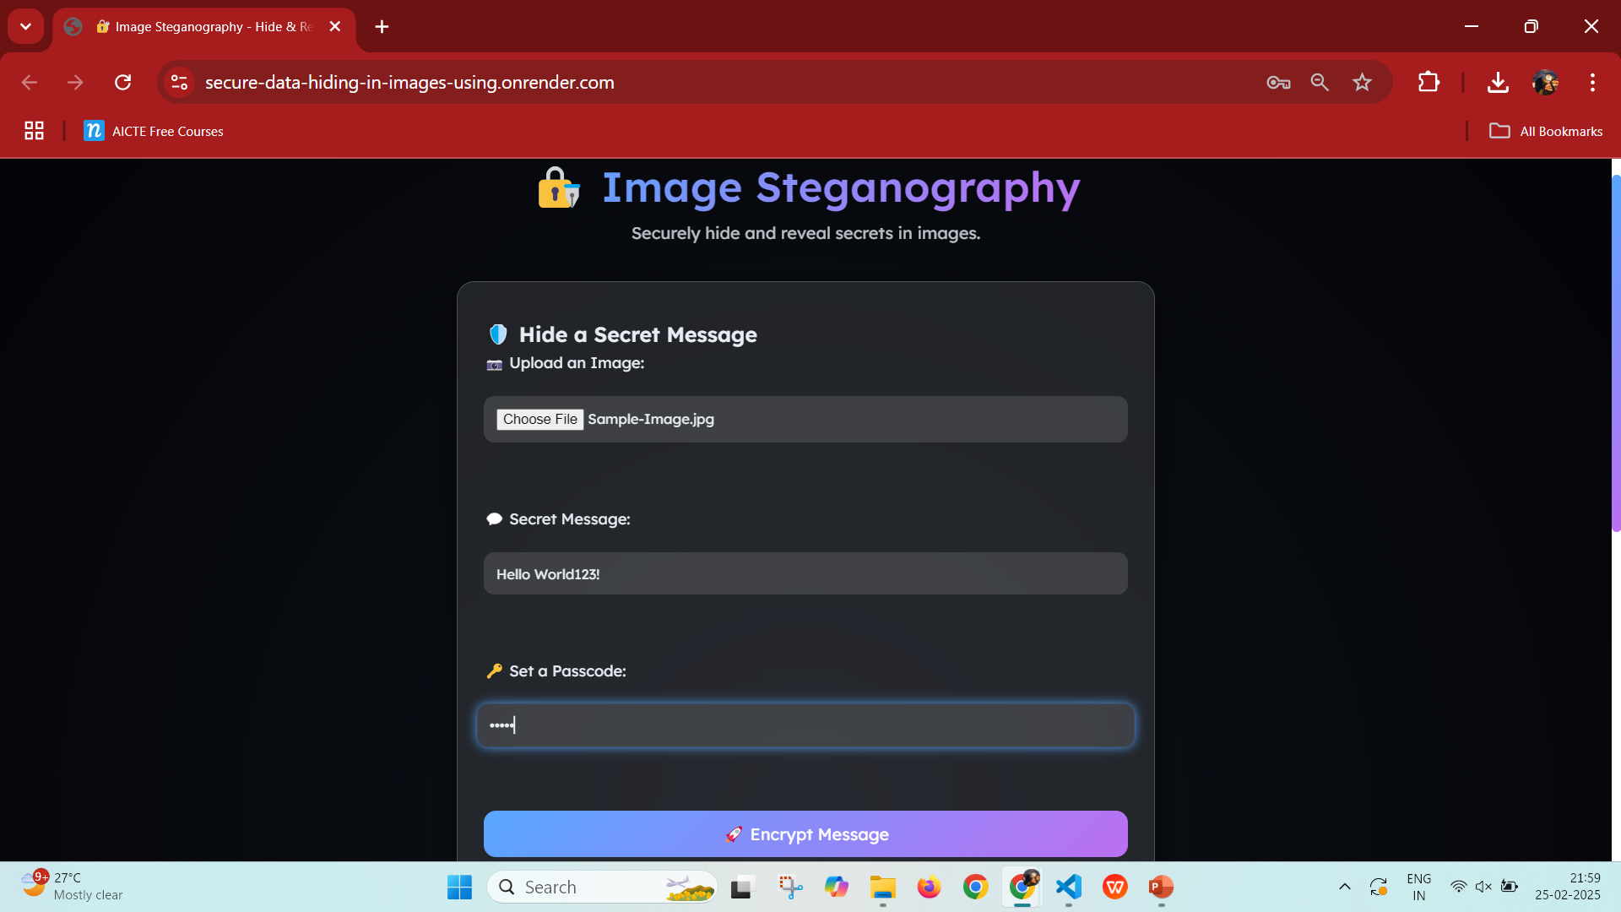
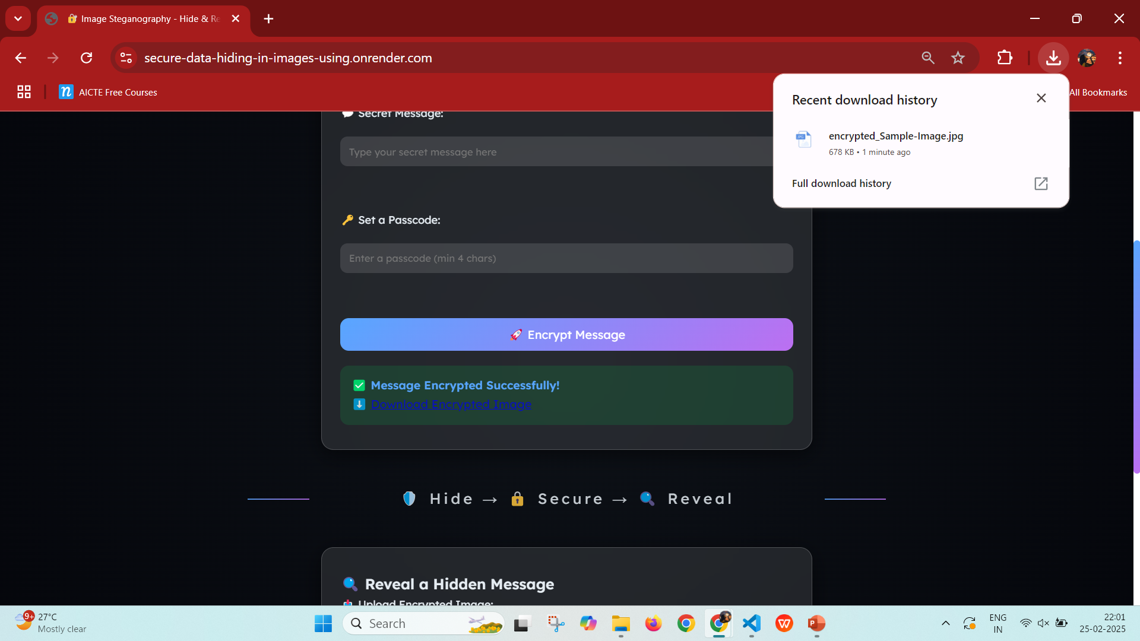

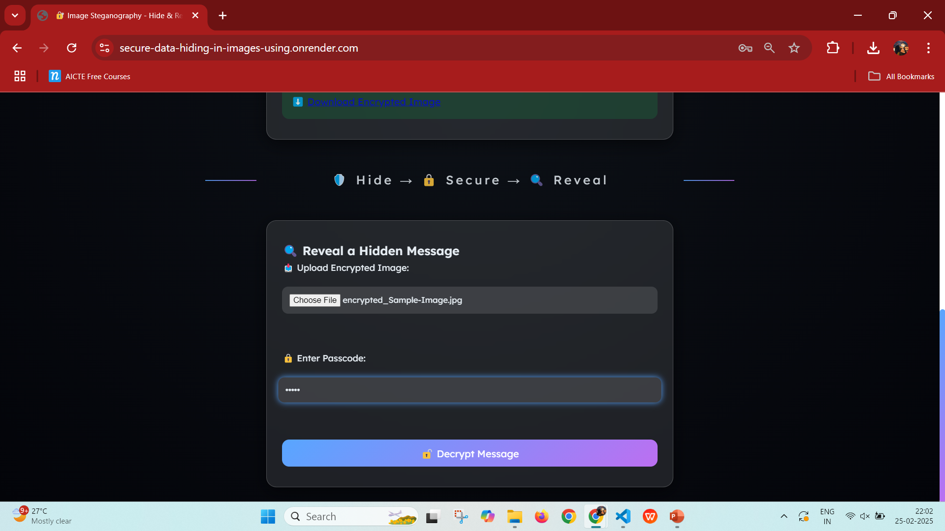
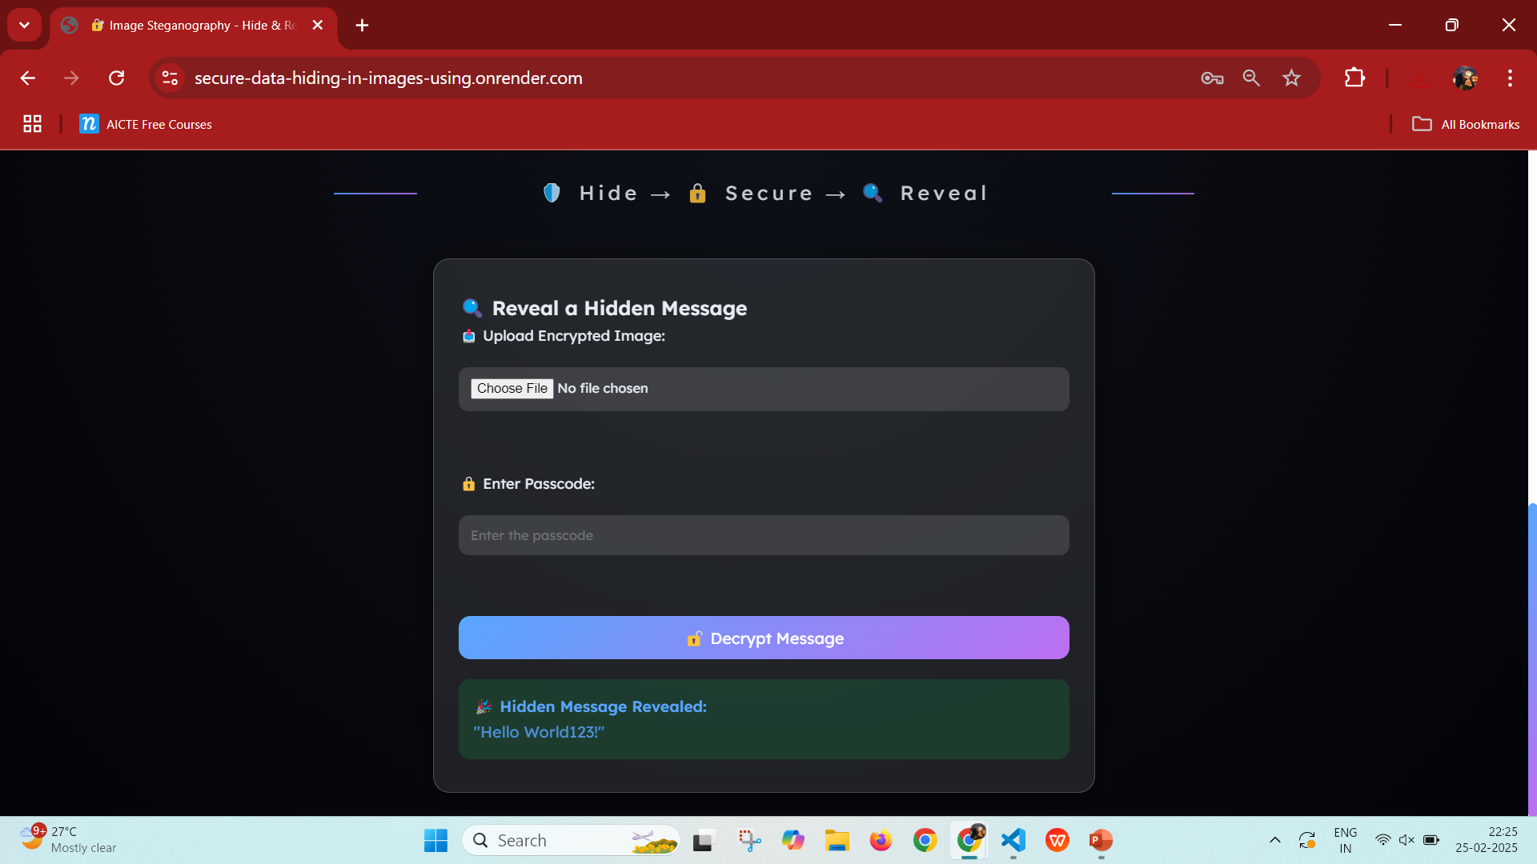

Results
Encrypting the message in the given image
Downloading the encrypted image
Sample-Image.jpg
Decrypting the message from encrypted image
Decrypted Message from the encrypted image
encrypted_Sample-Image.jpg

Slide 8
Conclusion
This project successfully addresses the need for secure communication by utilizing image steganography to encrypt and decrypt hidden messages. By embedding messages within image files, it offers a creative and effective way to maintain confidentiality and privacy. With user-friendly interfaces for both encryption and decryption, along with password protection, the project stands out by offering an accessible yet robust solution to modern privacy concerns. Through this tool, users can securely share messages while leveraging the strength of cryptographic techniques, demonstrating its potential for real-world applications in secure communication and data protection.

Slide 9
GitHub Link
GitHub Repository:
Link: Secure Data Hiding in Images using Steganography
NOTE : If the link is not working, please copy paste the below URL in your browser :
https://github.com/priyadharshini-261103/Secure-data-hiding-in-images-using-steganography
The repository contains the full code, including files for encryption and decryption of messages hidden in images using steganography.
Feel free to explore, contribute or clone the repository for your own use or further development.

Slide 10
Future scope(optional)
Multi-Layer Steganography: Develop the system to support multiple levels of steganography, allowing the hiding of several pieces of information within one image.
Support for Other Media: Extend the project to support hiding data in other media types like audio and video files, expanding its use cases.
Automated Message Extraction: Improve the decryption process by automating the extraction of messages from multiple images without manual intervention.
Integration with Blockchain for Verification: Integrate blockchain technology to verify the authenticity and integrity of encrypted messages, ensuring they have not been tampered with.

Slide 11
THANK YOU

